Slide 2
Learn steps to install Splunk on linux

Slide 3

Download via Browser
Go to Splunk's website;
Click on the "Free Splunk" button;

Slide 4
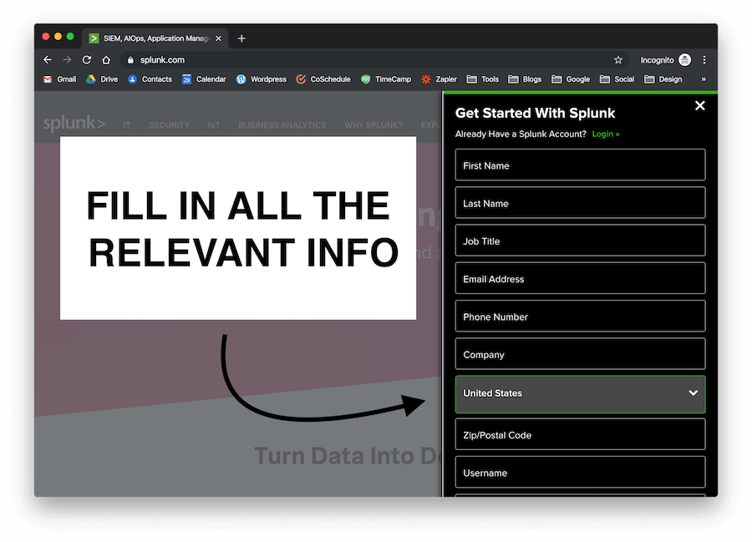
Download via Browser
3. Enter your personal information;

Slide 5
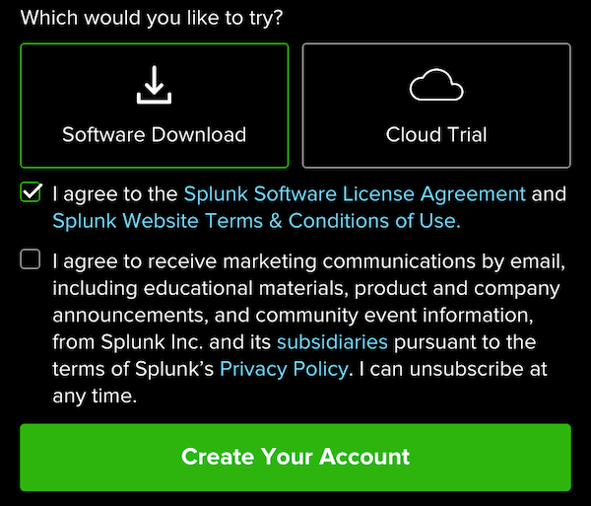
Download via Browser
4. Accept the Splunk Software License Agreement;

Slide 6
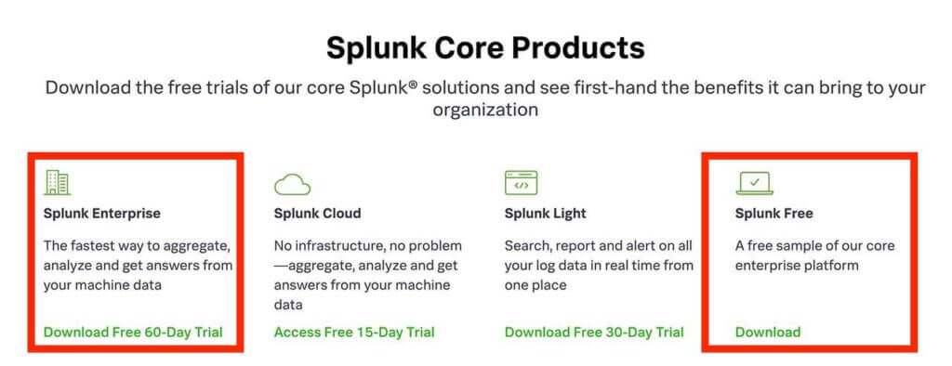
Download via Browser
5. Choose the product that suits your needs;

Slide 7
Download via Browser
6. Select the Linux tab;
7. Choose the correct file extension for your Linux distro (.tgz, .deb, .rpm) and click on the "Download Now" button to download Splunk.

Slide 8
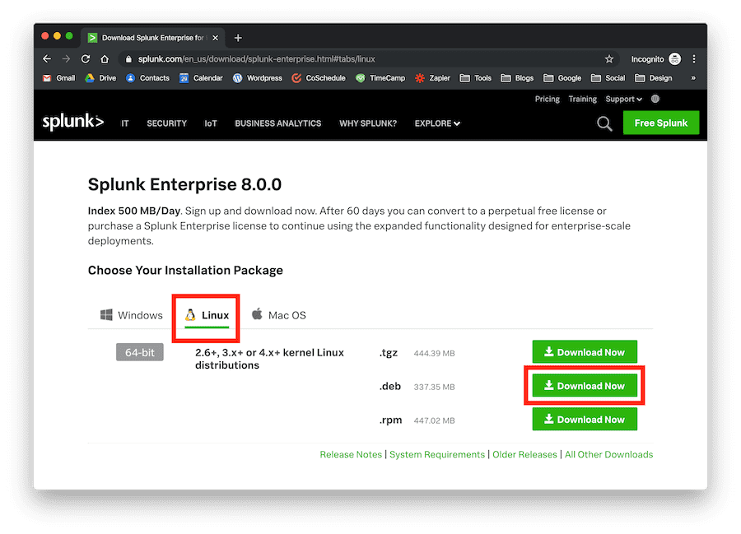
Download via Browser

